Slide 1
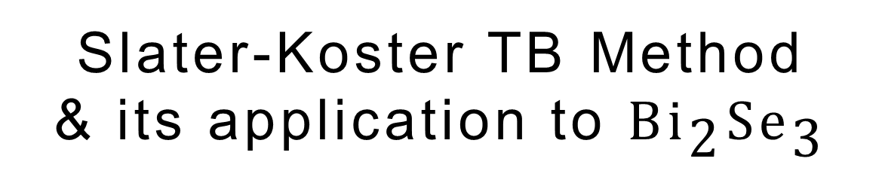
Slater-Koster TB Method
& its application to $\text{B}{\text{i}}_{\text{2}}\text{S}{\text{e}}_{\text{3}}$
Kaifa Luo
2017/12/30
luokaifa96@gmail.com

Slide 2
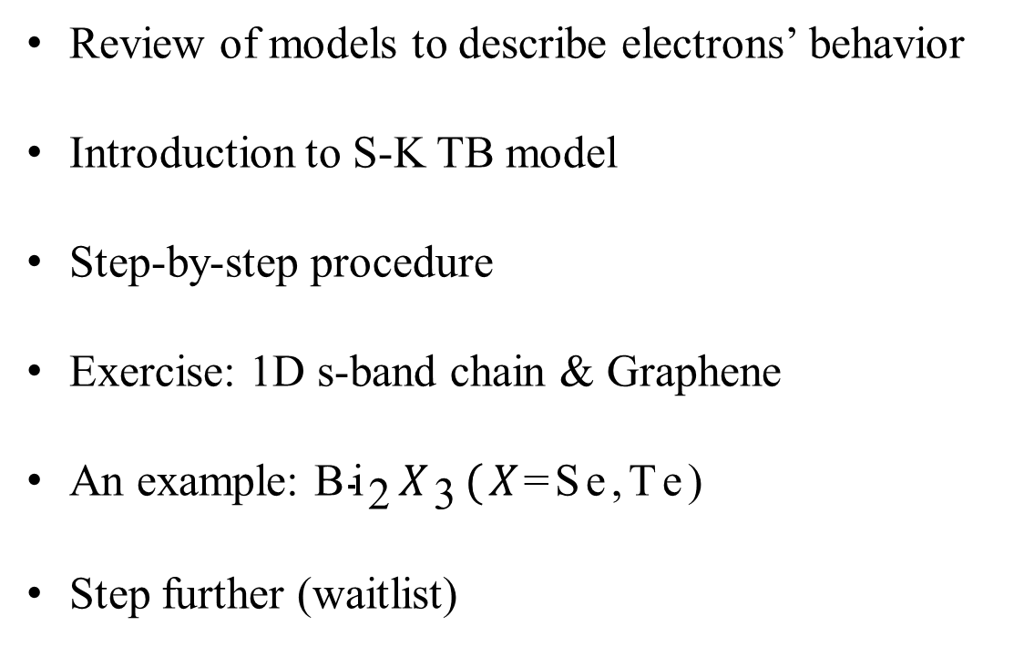
Outline
Review of models to describe electrons’ behavior
Introduction to S-K TB model
Step-by-step procedure
Exercise: 1D s-band chain & Graphene
An example: $\text{B}{\text{i}}_{\text{2}}X_{\text{3}}(X\text{=}\text{Se}\text{,}\text{T}\text{e}\text{)}$
Step further (waitlist)

Slide 3
Introduction to S-K TB model
What are (conventional) solid state materials?
Bloch theorem for non-interacting electrons in a periodic potential.
In solid state physics, the TB model is an approach to the calculation of electronic band structure using approximation set of wave functions based on superposition of wave functions for isolated atoms located at each atomic site. ——wiki
Historical development
1928, Robert Mulliken, the idea of a molecular orbital;
1928, B. N. Finklestein et al, the LCAO method for approximating molecular orbitals;
1928, Felix Bloch, extended to solids and called as LCAO-MO approach;
1954, Slater and Koster, the parameterized TB model method with effective interpolation scheme.
Features
Quantum mechanical; Single-electron
Like the many other physical models, tight-binding model is a typical and practical one, able to help us understand why solids behave as they are.
“Building a tight binding Hamiltonian yourself, by hand, is certainly the surest way to learn and understand the method.”

Slide 4
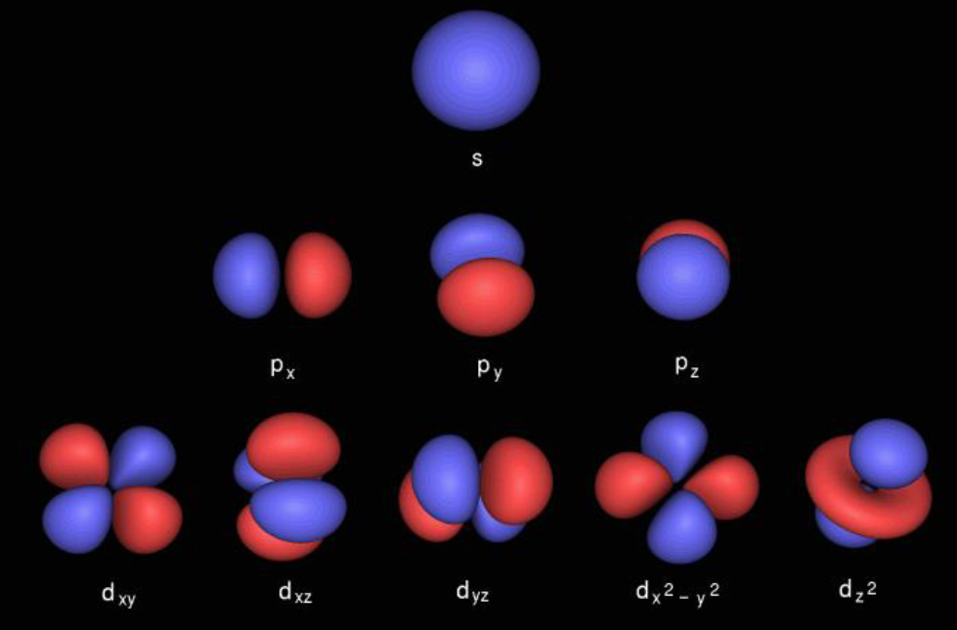

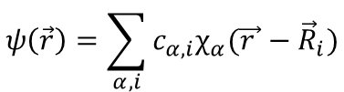
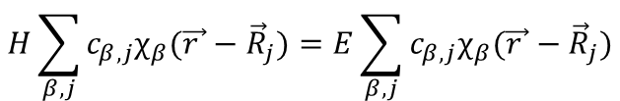

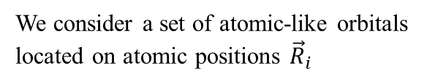

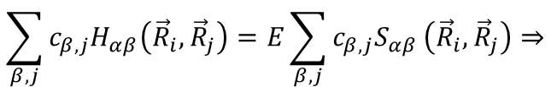
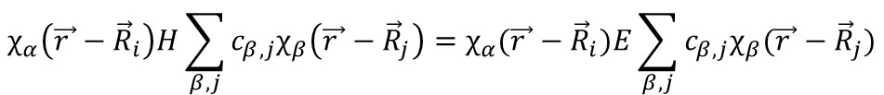
Construction of LCAO Hamiltonian
The LCAO idea is to express one-electron wave functions as a combination of atomic orbitals
We consider a set of atomic-like orbitals located on atomic positions ${\vec{R}}_{i}$
$$ψ\left(\vec{r}\right)=\sum_{α, i}{c_{α,i}χ_{α}(\vec{r }−{\vec{R}}_{i})}$$
Construct physical quantities over atomic functions
The Hamiltonian matrix elements
$$H_{αβ}\left({\vec{R}}_{i},{\vec{R}}_{j}\right)=〈χ_{α} ∣ H ∣ χ_{β}〉=∫d\vec{r}χ_{α}\left(\vec{r}−{\vec{R}}_{i}\right)Hχ_{β}\left(\vec{r}−{\vec{R}}_{j}\right)$$
The overlap matrix elements
$$S_{αβ}\left({\vec{R}}_{i},{\vec{R}}_{j}\right)=〈χ_{α}∣χ_{β}〉=∫d\vec{r}χ_{α}\left(\vec{r}−{\vec{R}}_{i}\right)χ_{β}\left(\vec{r}−{\vec{R}}_{j}\right)$$
Generalized eigenvalue problem
$$H\sum_{β, j}{c_{β,j}χ_{β}(\vec{r }−{\vec{R}}_{j})}=E\sum_{β, j}{c_{β,j}χ_{β}(\vec{r }−{\vec{R}}_{j})}$$
$$Hψ\left(\vec{r}\right)=Eψ\left(\vec{r}\right)⇒$$
$$χ_{α}\left(\vec{r }−{\vec{R}}_{i}\right)H\sum_{β, j}{c_{β,j}χ_{β}\left(\vec{r }−{\vec{R}}_{j}\right)}=χ_{α}(\vec{r }−{\vec{R}}_{i})E\sum_{β, j}{c_{β,j}χ_{β}(\vec{r }−{\vec{R}}_{j})}$$
$$\sum_{β, j}{c_{β,j}H_{αβ}\left({\vec{R}}_{i},{\vec{R}}_{j}\right)}=E\sum_{β, j}{c_{β,j}S_{αβ}}\left({\vec{R}}_{i},{\vec{R}}_{j}\right)⇒$$
$$H_{αβ}\left({\vec{R}}_{i},{\vec{R}}_{j}\right)=ES_{αβ}\left({\vec{R}}_{i},{\vec{R}}_{j}\right)$$
$$Hψ=ESψ$$

Slide 5
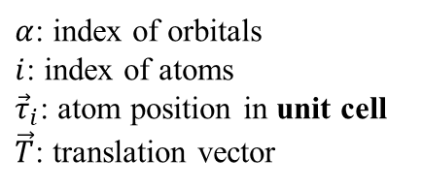
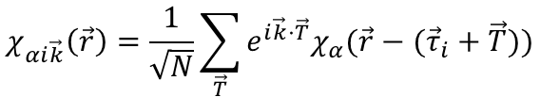
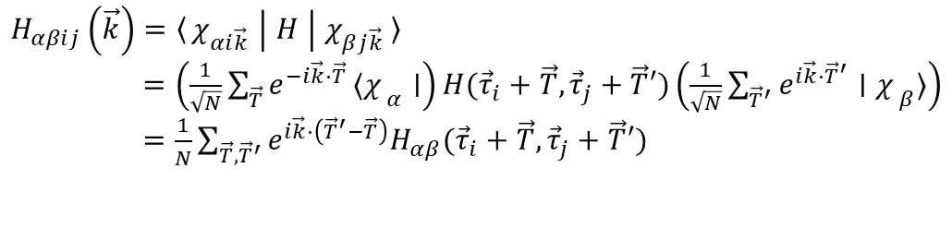
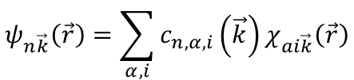
Construction of LCAO Hamiltonian
Take periodicity into consideration, and new set of orbitals can be defined
$$χ_{αi\vec{k}}\left(\vec{r}\right)=\frac{1}{\sqrt{N}}\sum_{\vec{T}}{e^{i\vec{k}·\vec{T}}χ_{α}(\vec{r}−({\vec{τ}}_{i}+\vec{T}))}$$
$α$: index of orbitals
$i$: index of atoms
${\vec{τ}}_{i}$: atom position in unit cell
$\vec{T}$: translation vector
$$ψ_{n\vec{k}}\left(\vec{r}\right)=\sum_{α,i}{c_{n,α,i}\left(\vec{k}\right)χ_{ai\vec{k}}\left(\vec{r}\right)}$$
Note: $χ_{αi\vec{k}}\left(\vec{r}\right)$ and $ψ_{n\vec{k}}\left(\vec{r}\right)$ are functions in k-space, while $\vec{r}$ is just a label fixed with frame of coordinates of lattice.
(Bloch) Hamiltonian becomes
$$H_{αβij}\left(\vec{k}\right)=〈χ_{αi\vec{k}} ∣ H ∣ χ_{βj\vec{k}}〉$$
$=\left(\frac{1}{\sqrt{N}}\sum_{\vec{T}}{e^{−i\vec{k}·\vec{T}}}〈{χ_{ }}_{α}∣\right)H({\vec{τ}}_{i}+\vec{T},{\vec{τ}}_{j}+\vec{T}′)\left(\frac{1}{\sqrt{N}}\sum_{{\vec{T}}^{′}}{e^{i\vec{k}·{\vec{T}}^{′}}}∣{χ_{ }}_{β}〉\right)$
$=\frac{1}{N}\sum_{\vec{T},{\vec{T}}^{′}}{e^{i\vec{k}·\left({\vec{T}}^{′}−\vec{T}\right)}H_{αβ}({\vec{τ}}_{i}+\vec{T},{\vec{τ}}_{j}+\vec{T}′)}$
What’s the insight?
1. The so-called electronic materials, are just electrons flying inside periodic lattice. LCAO method presents a very rough way to show that, once the wave function of atoms are known, you just need to pick them up and build blocks as children do.
2. LCAO method is a paradigm to feel the philosophy and methodology of reductionism, though it made relatively little achievements for it is too demanding in terms of calculation.

Slide 6
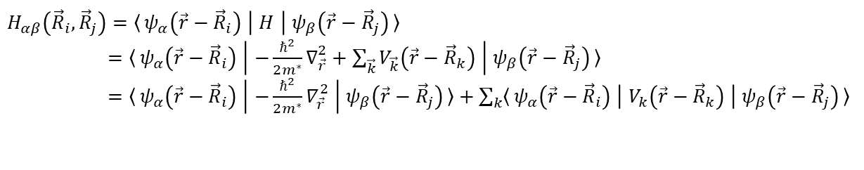


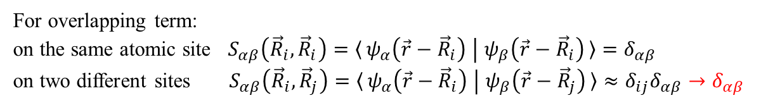
Two Key Approximations
Two centers approximation (Slater-Koster)
All overlap terms and Hamiltonian matrix elements involve only orbitals and potentials on two atomic sites.
$$H_{αβ}\left({\vec{R}}_{i},{\vec{R}}_{j}\right)=〈ψ_{α}\left(\vec{r}−{\vec{R}}_{i}\right) ∣ H ∣ ψ_{β}\left(\vec{r}−{\vec{R}}_{j}\right)〉$$
$=〈ψ_{α}\left(\vec{r}−{\vec{R}}_{i}\right) ∣ −\frac{ℏ^{2}}{2m^{∗}}∇_{\vec{r}}^{2}+\sum_{\vec{k}}{V_{\vec{k}}\left(\vec{r}−{\vec{R}}_{k}\right)} ∣ ψ_{β}\left(\vec{r}−{\vec{R}}_{j}\right)〉$
$=〈ψ_{α}\left(\vec{r}−{\vec{R}}_{i}\right) ∣ −\frac{ℏ^{2}}{2m^{∗}}∇_{\vec{r}}^{2} ∣ ψ_{β}\left(\vec{r}−{\vec{R}}_{j}\right)〉+\sum_{k}{〈ψ_{α}\left(\vec{r}−{\vec{R}}_{i}\right) ∣ V_{k}\left(\vec{r}−{\vec{R}}_{k}\right) ∣ ψ_{β}\left(\vec{r}−{\vec{R}}_{j}\right)〉 }$
What does two centers mean?
Keeping only $k=i$ or $k=j$, gives the two-center approximation, or else it is a three center tight-binding model.
Orthogonal approximation
For overlapping term:
on the same atomic site $S_{αβ}\left({\vec{R}}_{i},{\vec{R}}_{i}\right)=〈ψ_{α}\left(\vec{r}−{\vec{R}}_{i}\right) ∣ ψ_{β}\left(\vec{r}−{\vec{R}}_{i}\right)〉=δ_{αβ}$
on two different sites $S_{αβ}\left({\vec{R}}_{i},{\vec{R}}_{j}\right)=〈ψ_{α}\left(\vec{r}−{\vec{R}}_{i}\right) ∣ ψ_{β}\left(\vec{r}−{\vec{R}}_{j}\right)〉≈δ_{ij}δ_{αβ}→δ_{αβ}$
Löwdin theorem:
This is not an orthogonalized tight-binding where you transform your orbitals to be orthogonal.
$$H_{αβ}\left({\vec{R}}_{i},{\vec{R}}_{j}\right)=ES_{αβ}\left({\vec{R}}_{i},{\vec{R}}_{j}\right)≈Eδ_{αβ}$$
$Hψ=ESψ⇒$ $Hψ=Eψ$
Phys. Rev 94, 1498 (1956); P. O Löwdin, J. Chem. Phys. 18, 365(1950)

Slide 7
Schematics of three kinds of “hopping”
Onsite terms
Influenced by the presence of neighboring atoms
Two-center hopping integrals
The electron feels the attraction of both nuclei
I
J
Three-center hopping integrals
The electron between I and J is influenced by the presence of another atom K.
I
J
K
J. Kohanoff, CCMS Summer Institute, 2012

Slide 8
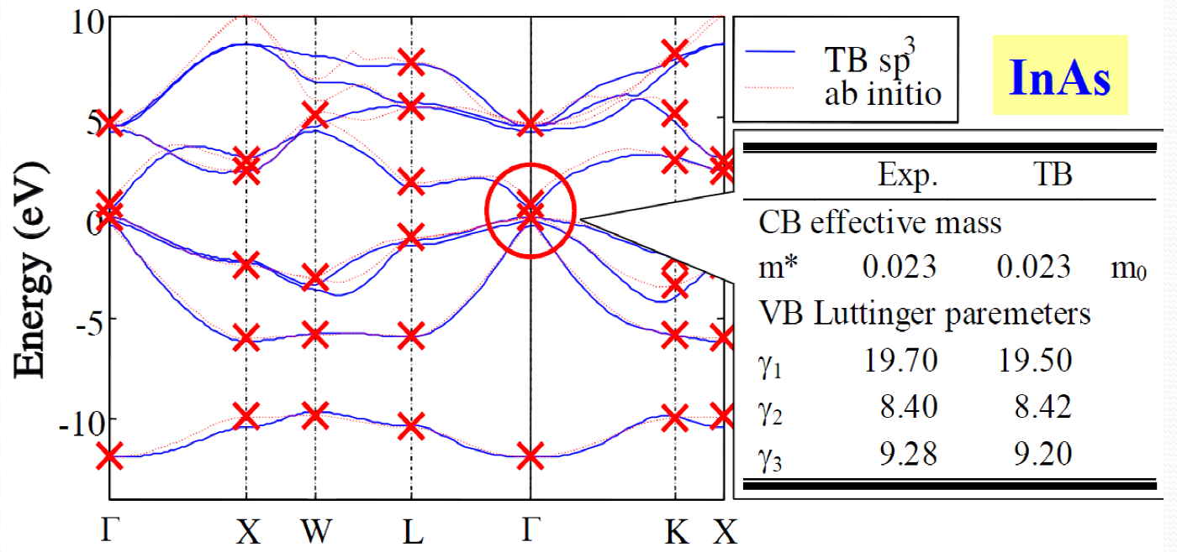
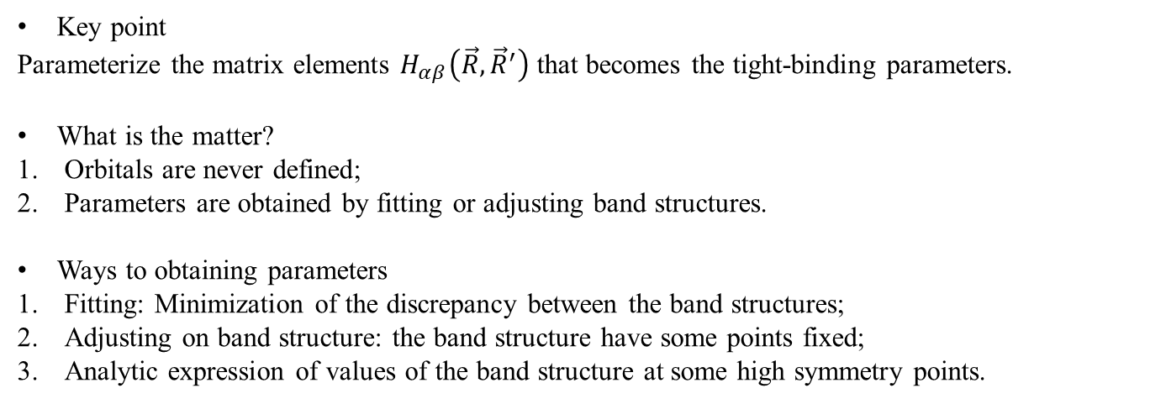
Semi-Empirical Tight-binding
Key point
Parameterize the matrix elements $H_{αβ}\left(\vec{R},{\vec{R}}^{′}\right)$ that becomes the tight-binding parameters.
What is the matter?
Orbitals are never defined;
Parameters are obtained by fitting or adjusting band structures.
Ways to obtaining parameters
Fitting: Minimization of the discrepancy between the band structures;
Adjusting on band structure: the band structure have some points fixed;
Analytic expression of values of the band structure at some high symmetry points.
Phys. Rev 94, 1498 (1956)

Slide 9
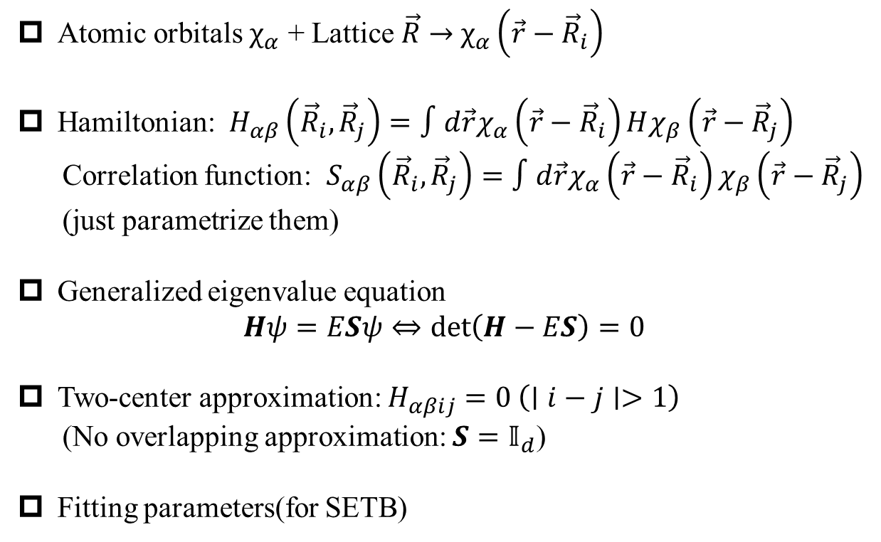
Step-by-step procedure
Atomic orbitals $χ_{α}$ + Lattice $\vec{R}$ $→$ $χ_{α}\left(\vec{r}−{\vec{R}}_{i}\right)$
Hamiltonian: $H_{αβ}\left({\vec{R}}_{i},{\vec{R}}_{j}\right)=∫d\vec{r}χ_{α}\left(\vec{r}−{\vec{R}}_{i}\right)Hχ_{β}\left(\vec{r}−{\vec{R}}_{j}\right)$
Correlation function: $S_{αβ}\left({\vec{R}}_{i},{\vec{R}}_{j}\right)=∫d\vec{r}χ_{α}\left(\vec{r}−{\vec{R}}_{i}\right)χ_{β}\left(\vec{r}−{\vec{R}}_{j}\right)$
(just parametrize them)
Generalized eigenvalue equation
$$Hψ=ESψ⇔\det\left(H−ES\right)=0$$
Two-center approximation: $H_{αβij}=0 \left(∣i−j∣>1\right)$
(No overlapping approximation: $S=𝕀_{d}$)
Fitting parameters(for SETB)

Slide 10
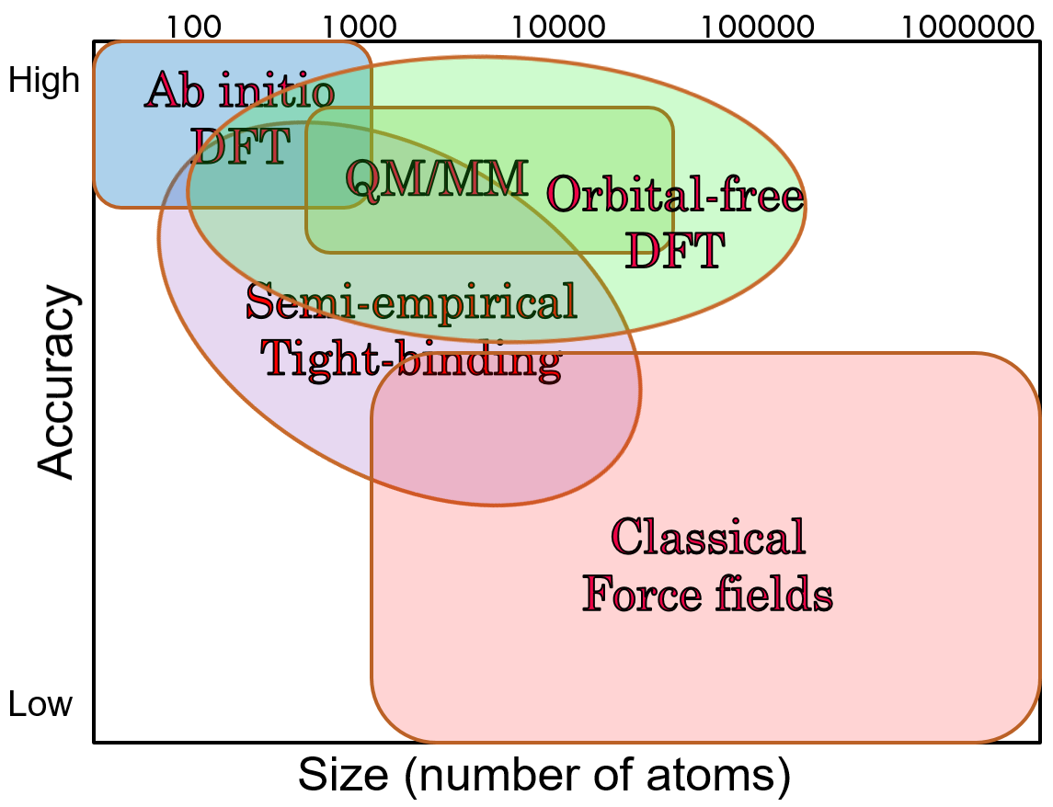
Overview
J. Kohanoff, CCMS Summer Institute, 2012

Slide 11
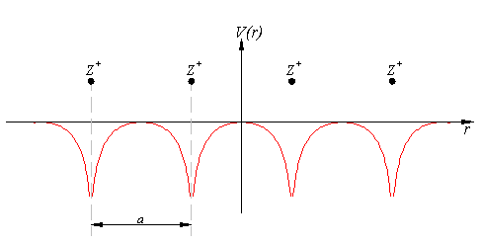
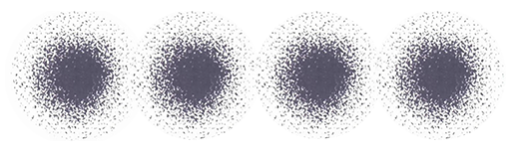
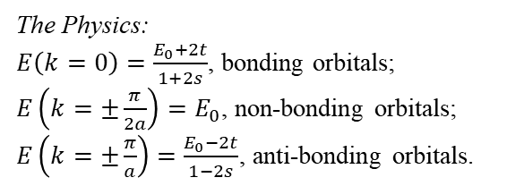
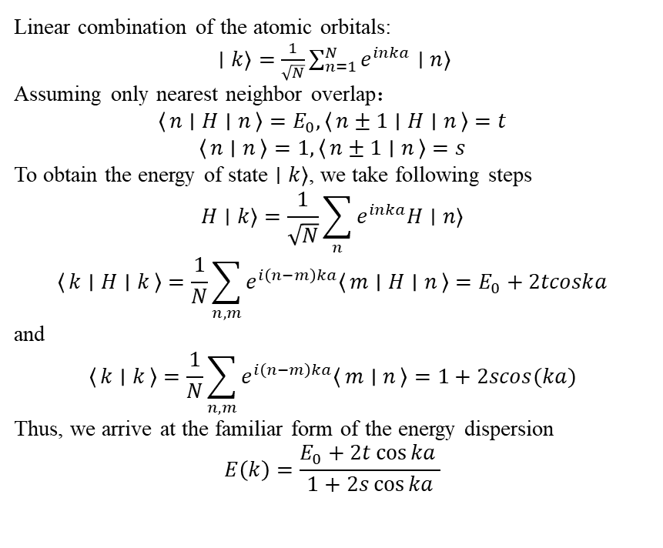
Exercise: 1D s-band
Linear combination of the atomic orbitals:
$∣k〉=\frac{1}{\sqrt{N}}\sum_{n=1}^{N}{e^{inka}∣n〉}$
Assuming only nearest neighbor overlap：
$$〈n ∣ H ∣ n〉=E_{0}, 〈n±1 ∣ H ∣ n〉=t$$
$$〈n ∣ n〉=1, 〈n±1 ∣ n〉=s$$
To obtain the energy of state $∣k〉$, we take following steps
$$H∣k〉=\frac{1}{\sqrt{N}}\sum_{n}{e^{inka}H∣n〉}$$
$$〈k ∣ H ∣ k〉=\frac{1}{N}\sum_{n,m}{e^{i\left(n−m\right)ka}〈m ∣ H ∣ n〉}=E_{0}+2tcoska$$
and
$$〈k ∣ k〉=\frac{1}{N}\sum_{n,m}{e^{i\left(n−m\right)ka}〈m ∣ n〉=1+2scos(ka)}$$
Thus, we arrive at the familiar form of the energy dispersion
$$E\left(k\right)=\frac{E_{0}+2t\cos{ka} }{1+2s\cos{ka}}$$
The Physics:
$E\left(k=0\right)=\frac{E_{0}+2t}{1+2s}$, bonding orbitals;
$E\left(k=±\frac{π}{2a}\right)=E_{0}$, non-bonding orbitals;
$E\left(k=±\frac{π}{a}\right)=\frac{E_{0}−2t}{1−2s}$, anti-bonding orbitals.

Slide 12
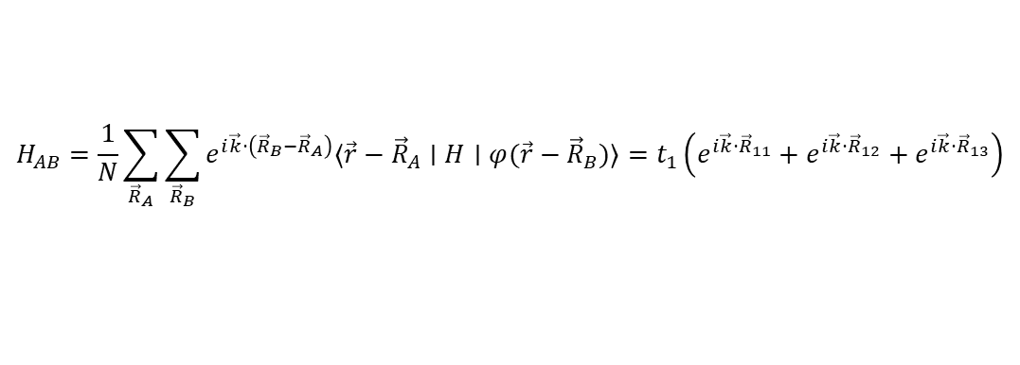
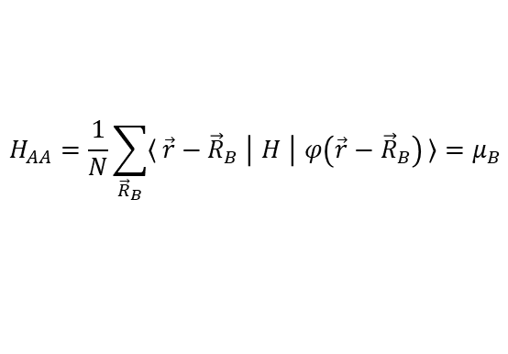
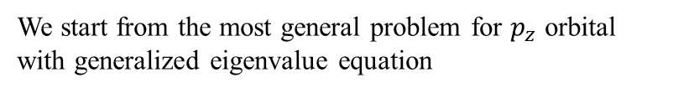

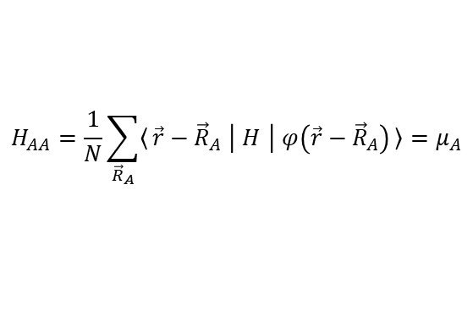
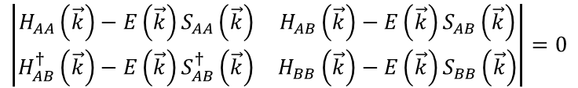



Exercise: Graphene
We start from the most general problem for $p_{z}$ orbital with generalized eigenvalue equation
$$\left(H−ES\right)ψ=0$$
$$\left|\begin{matrix}H_{AA}\left(\vec{k}\right)−E\left(\vec{k}\right)S_{AA}\left(\vec{k}\right) & H_{AB}\left(\vec{k}\right)−E\left(\vec{k}\right)S_{AB}\left(\vec{k}\right) \\ H_{AB}^{†}\left(\vec{k}\right)−E\left(\vec{k}\right)S_{AB}^{†}\left(\vec{k}\right) & H_{BB}\left(\vec{k}\right)−E\left(\vec{k}\right)S_{BB}\left(\vec{k}\right)\end{matrix}\right|=0$$
General solution:
$$E_{±}\left(\vec{k}\right)=\frac{−\left(−2E_{0}+E_{1}\right)±\sqrt{{\left(−2E_{0}+E_{1}\right)}^{2}−4E_{2}E_{3}}}{2E_{3}}$$
with $E_{0}=H_{AA}S_{AA}, E_{1}=S_{AB}H_{AB}^{†}, E_{2}=H_{AA}^{2}−H_{AB}H_{AB}^{†}, E_{3}=S_{AA}^{2}−S_{AB}S_{AB}^{†}$
Take tight-binding approximation, namely, limit the sums to the first nearest-neighbors
$$H_{AB}=\frac{1}{N}\sum_{{\vec{R}}_{A}}{\sum_{{\vec{R}}_{B}}{e^{i\vec{k}·\left({\vec{R}}_{B}−{\vec{R}}_{A}\right)}〈\vec{r}−{\vec{R}}_{A}∣H∣φ(\vec{r}−{\vec{R}}_{B})〉}}=t_{1}\left(e^{i\vec{k}·{\vec{R}}_{11}}+e^{i\vec{k}·{\vec{R}}_{12}}+e^{i\vec{k}·{\vec{R}}_{13}}\right)$$
Parameter: $t_{1}=〈φ_{A}\left(\vec{r}−{\vec{R}}_{A}\right) ∣ H ∣ φ_{B}\left(\vec{r}−{\vec{R}}_{A}−{\vec{R}}_{1i}\right)〉 (i=1,2,3)$
$$S_{AB}=s_{1}\left(e^{i\vec{k}·{\vec{R}}_{11}}+e^{i\vec{k}·{\vec{R}}_{12}}+e^{i\vec{k}·{\vec{R}}_{13}}\right)$$
Parameter: $s_{1}=〈φ_{A}\left(\vec{r}−{\vec{R}}_{A}\right)∣φ_{B}\left(\vec{r}−{\vec{R}}_{A}−{\vec{R}}_{1i}\right)〉 (i=1,2,3)$
$$H_{AA}=\frac{1}{N}\sum_{{\vec{R}}_{A}}{〈\vec{r}−{\vec{R}}_{A} ∣ H ∣ φ\left(\vec{r}−{\vec{R}}_{A}\right)〉=μ_{A}}$$
$$H_{AA}=\frac{1}{N}\sum_{{\vec{R}}_{B}}{〈\vec{r}−{\vec{R}}_{B} ∣ H ∣ φ\left(\vec{r}−{\vec{R}}_{B}\right)〉=μ_{B}}$$
$$S_{AA}=S_{BB}=1$$
S. Reich, et al. PRB 66, 035412 (2002)

Slide 13

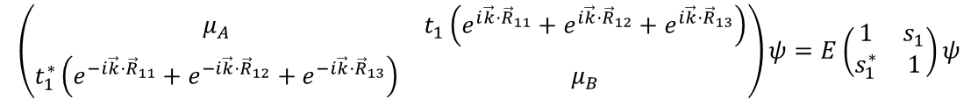
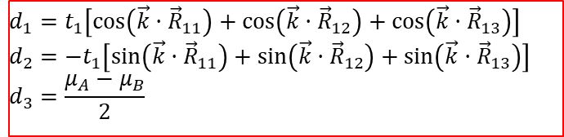
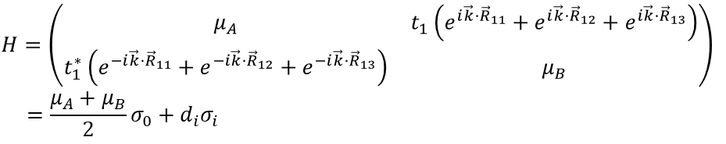
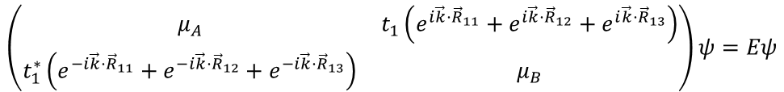
Exercise: Graphene
Now, we arrive at a Slater-Koster Hamiltonian and its eigenvalue equation
$$\left(\begin{matrix}μ_{A} & t_{1}\left(e^{i\vec{k}·{\vec{R}}_{11}}+e^{i\vec{k}·{\vec{R}}_{12}}+e^{i\vec{k}·{\vec{R}}_{13}}\right) \\ t_{1}^{∗}\left(e^{−i\vec{k}·{\vec{R}}_{11}}+e^{−i\vec{k}·{\vec{R}}_{12}}+e^{−i\vec{k}·{\vec{R}}_{13}}\right) & μ_{B}\end{matrix}\right)ψ=E\left(\begin{matrix}1 & s_{1} \\ s_{1}^{∗} & 1\end{matrix}\right)ψ$$
No overlapping approximation, i.e. orthogonal tight-binding: $s_{1}=0$
$$\left(\begin{matrix}μ_{A} & t_{1}\left(e^{i\vec{k}·{\vec{R}}_{11}}+e^{i\vec{k}·{\vec{R}}_{12}}+e^{i\vec{k}·{\vec{R}}_{13}}\right) \\ t_{1}^{∗}\left(e^{−i\vec{k}·{\vec{R}}_{11}}+e^{−i\vec{k}·{\vec{R}}_{12}}+e^{−i\vec{k}·{\vec{R}}_{13}}\right) & μ_{B}\end{matrix}\right)ψ=Eψ$$
$$H=\left(\begin{matrix}μ_{A} & t_{1}\left(e^{i\vec{k}·{\vec{R}}_{11}}+e^{i\vec{k}·{\vec{R}}_{12}}+e^{i\vec{k}·{\vec{R}}_{13}}\right) \\ t_{1}^{∗}\left(e^{−i\vec{k}·{\vec{R}}_{11}}+e^{−i\vec{k}·{\vec{R}}_{12}}+e^{−i\vec{k}·{\vec{R}}_{13}}\right) & μ_{B}\end{matrix}\right)$$
$$=\frac{μ_{A}+μ_{B}}{2}σ_{0}+d_{i}σ_{i}$$
$$d_{1}=t_{1}\left[\cos\left(\vec{k}·{\vec{R}}_{11}\right)+\cos\left(\vec{k}·{\vec{R}}_{12}\right)+\cos\left(\vec{k}·{\vec{R}}_{13}\right)\right]$$
$$d_{2}=−t_{1}\left[\sin\left(\vec{k}·{\vec{R}}_{11}\right)+\sin\left(\vec{k}·{\vec{R}}_{12}\right)+\sin\left(\vec{k}·{\vec{R}}_{13}\right)\right]$$
$$d_{3}=\frac{μ_{A}−μ_{B}}{2}$$
$$E_{±}\left(\vec{k}\right)=d_{0}±\sqrt{d_{1}^{2}+d_{2}^{2}+d_{3}^{2}}$$
S. Reich, et al. PRB 66, 035412 (2002)

Slide 14
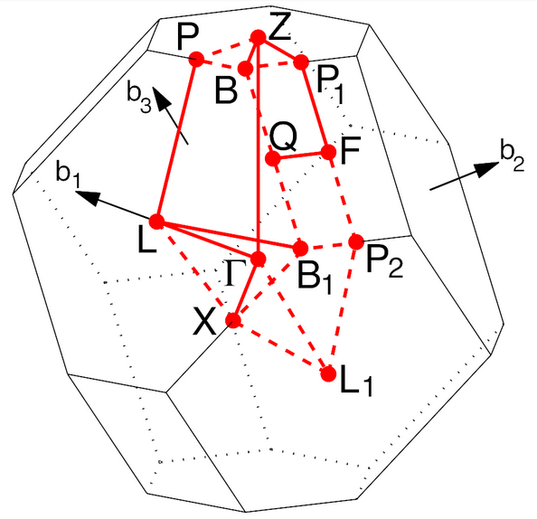
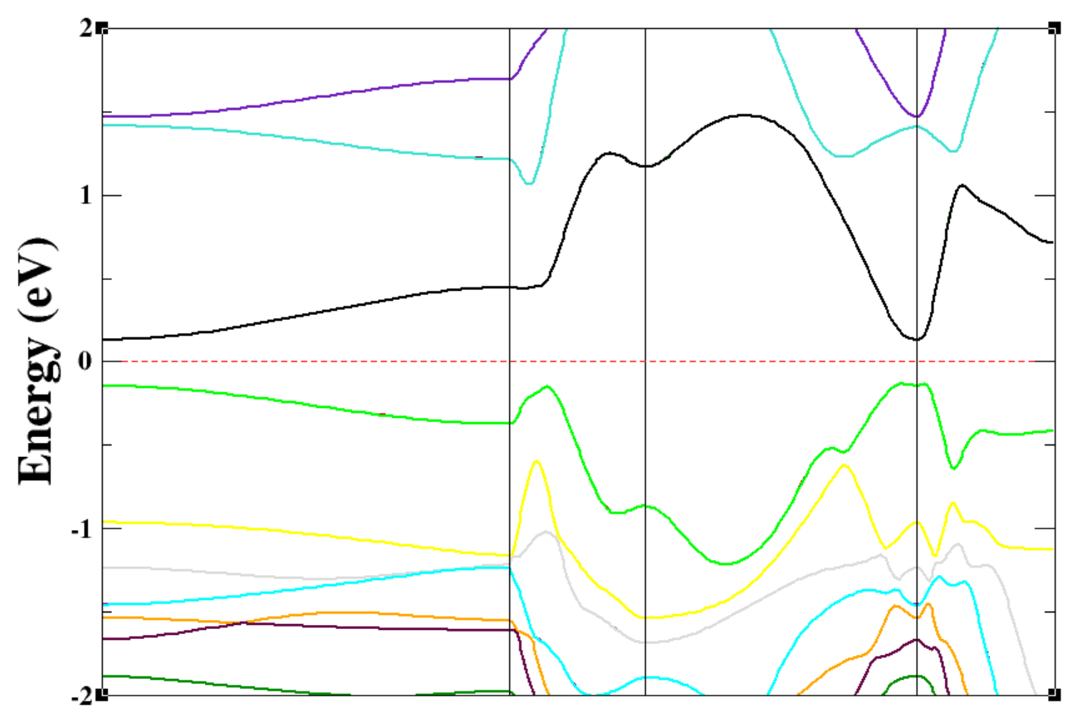
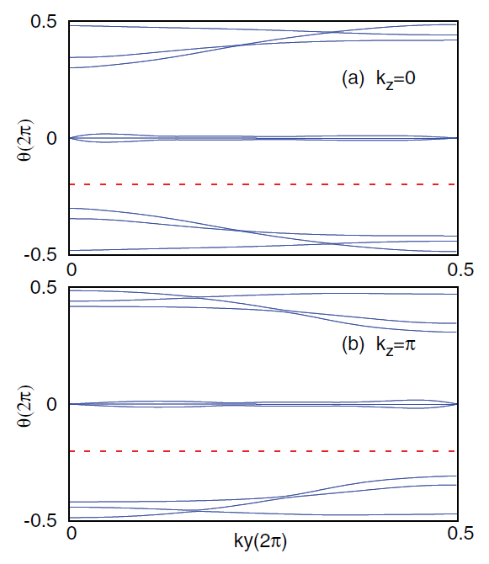
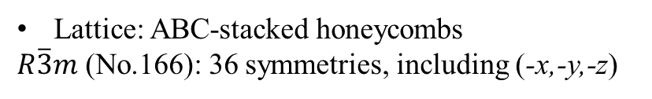

$\text{B}{\text{i}}_{\text{2}}\text{S}{\text{e}}_{\text{3}}/\text{B}{\text{i}}_{\text{2}}\text{T}{\text{e}}_{\text{3}}$
Lattice: ABC-stacked honeycombs
$R\overline{3}m$ (No.166): 36 symmetries, including (-x,-y,-z)
Band structure
Wannier center ($ℤ_{2}$)
Assignments:
Surface state
Spin texture

Slide 15
Improving the tight-binding model
Linear-muffin-tin orbitals tight-binding (LMTO-TB)
Hartree-Fock-based TB
Ab initio multicenter TB
DF-based TB (DFTB)
DFT equations + tight-binding approximation
Self-consistent charge DFTB

